Slide 1
Open Studios
Best Practices and Checklist
Notes:
Hello and welcome to our Open Studios Webinar. I’m Frank Trozzo, the committee chair this year. We are happy to have you join us this evening and thank you for tuning in. We are here to talk about the event and answer any questions you may have. This will be especially useful if you’ve never participated in OS before and don’t know what to expect. Some of you veterans may also learn something new that will help make the show go smoothly and increase your sales. Before we go further I’d like to introduce our OS steering committee team.

Slide 2
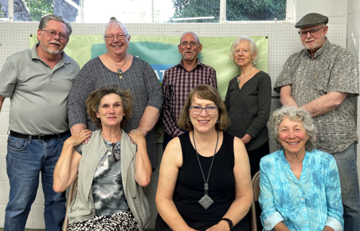
Open Studios Steering Committee 2022
Frank Trozzo Janis Adams
Michael Fitzpatrick
Diane Slade
Dennis Smith
Zaza Fetterly
Theresa Lawless
Karen Winograde
Notes:
We are all volunteers and give our time freely and do our best to make the event a successful one for each of you. These folks have stepped up to make this happen. I’m grateful for their dedication and help. The event wouldn't’ go on without them.
Names…
We’ve been working hard all year. There’s a lot of moving parts that have to mesh together, from the planning and programming. We solicit advertising, do the graphic design, write the articles, Manage the printing of the catalog and coordinate the event.
We have 70 participants this year and There is a lot to cover. Each of us will share some insights and answer any questions.
Theresa will be monitoring the chat. If you have a question please type it in and we will do our best to answer it..
We’ll be recording this and posting it on the AANV.org website. The checklist will also be posted on our site.
If you want to be on the team next year we would love to have you.
The money we make from this goes to our programs and scholarships for the Napa College and High school students who wish to study art as a profession.

Slide 3
Preparation
Planning and Marketing

Slide 4
2 Months before the show: Develop your marketing plan:
Social media, email, postcards, flyers, mailing list, etc.
Design and order postcards if desired (Moo, Vista Print)
Develop Mailing List (Mail chimp email program)
Check business card supply and order if necessary
Resale license for the state, business license is required in Napa city not county. (You can get a temporary business license for your site). Online Applications
California Seller's Permit Application | Tax ID Bureau (tax-id-bureau.com) Business Licenses | Napa, CA (cityofnapa.org)
Frank Trozzo
Notes:
You are the most important ingredient. there are no guarantees that you will make sales at the show. If you do the work you will get traffic to your site and the more traffic, the more sales you’ll make.
My experience…..
Something good always comes from the shows.
Organize your email list of friends fans and family.
Develop marketing plan: social media, postcards, flyers, mailing list, etc.
Design and order postcards if desired (Moo, Vista Print)
Develop Mailing List (Mail chimp)
Check business card supply and order if necessary
Resale license, business license (temporary business license for the site you’re showing. Go online to find the forms you need.

Slide 5
Two Weeks Before:
Let everyone know where you will be….
Send emails to friends, fans, family, contacts, and collectors.
Post images on social media once a day up to the day of the event.
Frank Trozzo
Notes:
I’d like to turn it over to my colleague Dennis Smith

Slide 6
One Week Before:
Determine what artworks, prints, and greeting cards you are bringing
Prep all artwork, frames, and hanger hardware
Set up display racks and test out the layout. Take pictures for easy setup later
Make sure all kit is in good repair. Pack everything the night before
Prepare price list, create labels or price items
Make sure your membership in the AANV is up to date
Dennis Smith
Notes:
Determine what artworks, prints, and greeting cards you are bringing
Prep all artwork, frames, and hanger hardware
Set up display racks and test out the layout. Take pictures
Make sure all kit is in good repair. Pack everything the night before
Prepare price list, create labels or price items
Make sure your membership is up to date

Slide 7
The Night Before:
Pack everything: artwork, displays, tent, receipt books, order forms, Guest list
Charge your cell phone, check blue tooth connection
Pack your Square reader or any other payment devices. Check everything. Bring your phone charger or battery backup
Does the site have internet access? What alternatives if not?
Dennis Smith
Notes:
Pack Square reader or other payment devices, charge cell phone, check blue tooth connection
Bring cell phone chargers or battery backup
Pack everything the night before

Slide 8
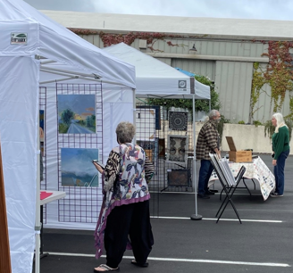
Canopy tent with sides
Sand bags for anchoring canopy tent
Display racks
Hanging hooks
Booth panels/walls
Folding chairs
Tables
Table cloths (amazon fitted table cloths
Curtains and clips for back of display
Print Stand
Card rack
Candy dish
Portable music speaker
Plastic tarps in case of rain
Name banner
Flowers
Artist profile
Printouts, magazine articles, catalogs
Tall folding chair so that if you’re sitting and stand up to talk it’s a less abrupt movement
Mirror (jewelry or clothing)
Janis Adams
Notes:
The checklist is be posted on our site. I’d like to turn it over to Janis Adams, our president to talk about displays and essential items.

Slide 9
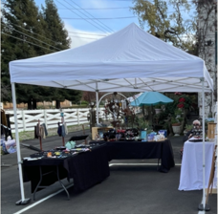
Money: Small bills to make change. $100
Smart Phone with payment system (Square Reader)
Cell phone charger
Business cards
Bill of sale forms
Guest list /sign-up sheet
Receipt book
Bags for purchases / Bubble wrap
Calculator
Paper and tape for wrapping
Change purse or fanny pack
Janis Adams
Notes:
Money: Small bills to make change. $100
Smart Phone with payment system (Square Reader)
Cell phone charger
Business cards
Bill of sale forms
Guest list /sign-up sheet
Receipt book
Bags for purchases
Calculator
Paper and tape for wrapping
Change purse or fanny pack

Slide 10
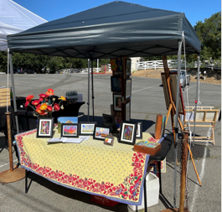
Essential Items
Bottled water
Food
Cooler
Hand fan for hot days
Hand sanitizer, masks
Sun lotion, sun glasses
Hat
Tissues
Janis Adams

Slide 11
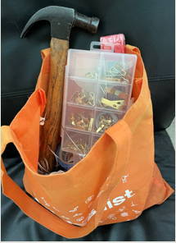
Tool Kit
Hammer, utility knife, screwdriver,
wire cutters, needle-nose pliers
Paper Towels, soft cloth
Glass cleaner (Windex)
Rope, cording, bungees
Nylon straps
Duct tape, masking tape
Zip ties of various sizes
Scissors
Clips, safety pins, picture wire
Zaza Fetterly
Notes:
Zaza
Hammer, utility knife, screwdriver,
wire cutters, needle-nose pliers
Paper Towels, soft cloth
Windex
Rope, cording, bungees
Nylon straps
Duct tape, masking tape
Zip ties of various sizes
Scissors
Clips, safety pins

Slide 12
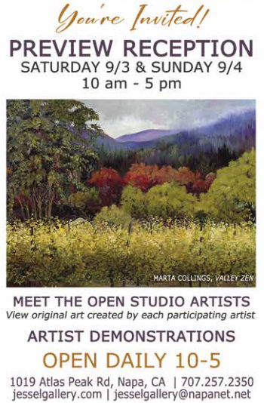
Jessel Preview Show
Drop off your work on (TBA)
Jessel’s requirements:
Bring 2 works for her to choose
Priced the same as your website
Commission split is 40% Gallery, 60% to Artist
Details for opening weekend
Pick up your work Friday Sept 30th 10 -5
Karen Winograde
Notes:
Karen Winograde

Slide 13
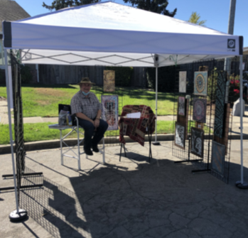
Pointers
Make an inventory list for reference
Display your art professionally.
Frame or mat the art
Protect your matted artwork with
Clear bags/ Clearbags.com or Amazon
Use a print display stand
Price everything, make labels
Flowers
Music
Candy dish
Be personable and smile
Frank Trozzo
Notes:
A couple of pointers
Dennis has talked about this earlier, but a few things to remember to make your show go smoothly
Make an inventory list on your computer with Excel or another spreadsheet program to keep track of what you have and what sold.
Display your art professionally, mat and frame your 2d art, hangers on the back of the frames
Don’t put everything in a box and expect people to rummage through it.
Prices or labels on everything
Some people have a Name banner, some use an iPad with videos of them at work
Music and flowers to make their experience more enjoyable. Candy dish for kids (not chocolate) Remember to smile and be personable even if you’re not having a good day.

Slide 14
Signs:
Each returning artist will receive a new sign
New artists will receive 2 signs
Artists can buy additional signs for $10 ea.
Sign and Catalog pickup will be announced
Catalogs:
Alan Vaughn will be in charge of the distribution so we don’t overlap locations
Each Artist will receive 25 Catalogs to distribute
We appreciate those members who distribute more
Catalogs will be available at Cartons and Crates which is near Color Theory Art Supply
3250 California Blvd. Napa 94558
Frank Trozzo
Notes:
Each returning artist will receive a new sign New artists will receive 2 signs to direct traffic to their location
We’ll announce when you can get the signs and catalogs

Slide 15
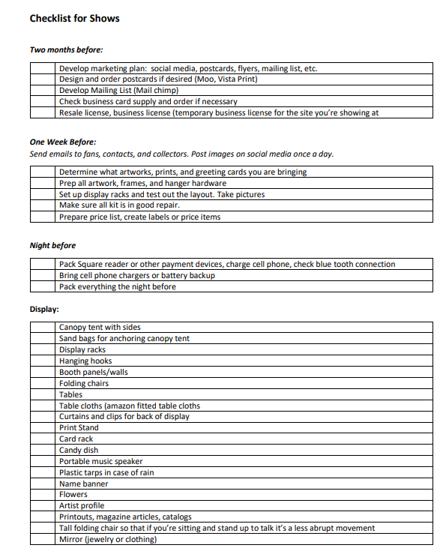
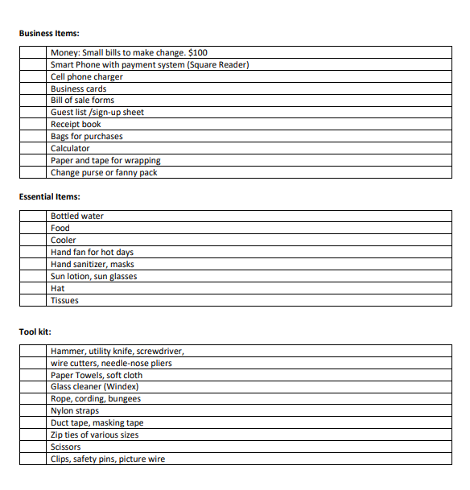
The checklist is available at:
Participate In Open Studios 2022 – Art Association Napa Valley (artnv.org)
Frank Trozzo
Notes:
There is a checklist on our website that you can download. If you go to Artnv.org and click the OS logo, under the first menu you’ll find “participate in OS”
You’ll find a link to the checklist and a copy of this presentation that you can download.

Slide 16
Questions?
Frank Trozzo
Frank@artnv.org
707 637 3766
Notes:
If you have any more questions you can type in the chat.
Thank you all for joining us. If you have further questions contact me by email or call me at the number above.
We hope you will have the best show ever. This is Frank Trozzo and the OS team signing off.

